Slide 1
University of Diyala College of Engineering Dept. of Communications

Slide 2
“ Digital Communications “ By Haidar N. Al-Anbagi Lec (9) Time: (4 hrs) 2017

Slide 3
Output SNR:
When calculating SNR, errors have to be considered first. Errors in DM lie in the range (- σ , σ), while in PCM, the errors lie in the range (- Δ/2, Δ/2).
The granular noise power is $ε^{2}$ = $σ^{2}$ (3)
Granular noise in equation (3) has a continuous spectrum power spectral density (PSD) with the most power concentrated in the range beyond $f_{s}$. As a result, the granular noise power $N_{o}$ at the output will be below the one in equation 3.
Depending on the fact that the total power $σ^{2}/3$ is uniformly distributed over the bandwidth $f_{s}$ , the power within the baseband B is

Slide 4
$N_{0}=$ ${(σ}^{2}/3)$ (B/$f_{s}$) = $σ^{2}$ B / 3$f_{s}$ (4)
The power of the output signal is:
$S_{0}$ = $m^{2}(t)$, then the SNR can be calculated as
$S_{0}/N_{0}$= 3$f_{s}m^{2}(t)$ / ${(σ}^{2}B)$ (5)
From equation 2,
$A_{max}$= $m_{p}=$ σ $f_{s}$ / $w_{r}$
Therefore, σ = $w_{r}$ $m_{p}$/ $f_{s}$ (6)
The substitution of σ in equation 5 yields,

Slide 5
$S_{0}/N_{0}$= (3$f_{s}m^{2}(t)$ / $B)$. ($\frac{{f_{s}}^{2}}{{m_{p}}^{2} {w_{r}}^{2}}$) = $\frac{3{f_{s}}^{3} m^{2}(t)}{B {m_{p}}^{2} {w_{r}}^{2}}$ (7)
If we want to transmit $f_{s}$ pulses per second, the minimum BW is
$B_{T}$ = $f_{s}/2$
Also, B for voice channels = 4000
$w_{r}=2∗π∗800=1600π, then$
$\frac{S_{0}}{N_{0}}= \frac{150}{π^{2}}$ ${(\frac{B_{T}}{B })}^{3}\frac{ m^{2}(t)}{{m_{p}}^{2} }$ (8)
Equation 8 computes the SNR for the single integration version while the following equation computes the double integration SNR:
$\frac{S_{0}}{N_{0}}= 5.34$ ${(\frac{B_{T}}{B })}^{5}\frac{ m^{2}(t)}{{m_{p}}^{2} }$ (9)

Slide 6
SNR of DM versus SNR of PCM:
In DM, SNR varies proportionally with ${(\frac{B_{T}}{B })}^{3}$ for the single integration DM and with ${(\frac{B_{T}}{B })}^{5}$ for the double integration. On the other hand, in PCM, SNR varies exponentially with $\frac{B_{T}}{B }$. For large values of $\frac{B_{T}}{B } ,$ PCM performs better than DM. whereas, for small values of $\frac{B_{T}}{B } ,$ DM performs better than PCM. Figure (4), shows SNR ratios for some $\frac{B_{T}}{B }$ values for both PCM and DM.

Slide 7
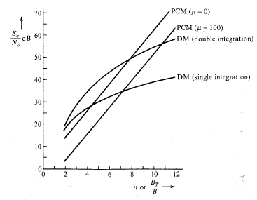
Figure (4) SNR of PCM versus SNR of DM

